Slide 1

SQL JSON Tools…wait, what?
A developer’s use cases
/r/iama:
Java developer #donthatemebro
SQL Server n00b
Slide deck, examples, SQL script at https://github.com/tsaiclone/json-demo
No pictures please
Notes:
I’m a full-time Java developer
Everything in this presentation and more is available on GitHub, so no pictures needed
Don’t want to break your camera
Sears camera anecdote
Jasons:
Jason Alexander = Seinfeld
Jason Bourne = Bourne series
Jason Lee = My Name is Earl
Jason Bateman = Arrested Development
Jason Priestley = 90210
Jason Sudeikis = SNL, 30 Rock
Jason Voorhees= Friday 13th character
Jason Statham = actor in Transporter movie series
Jason Lee Scott = power ranger character (was red and then advanced into gold)

Slide 2


Slide 3

JSON is…
JavaScript Object Notation
Clean, schema-less, typed XML
{ "statement_descriptor":"Monthly pmt", "amount":95489427, "description":"Payment for Ana Reid", "currency":"USD", "source":{ "number":"4000056655665556", "cvc":"171", "address_line1":"5536 w 6th st", "address_country":"USA", "name":“Ana Reid", "address_state":"CO", "exp_month":"7", "exp_year":"2017", "address_zip":"20689", "object":"card", "address_city":“Frederick" }, "username":"silvergorilla729" }
<?xml version="1.0" encoding="UTF-8" standalone="no" ?>
<charge xmlns="http://www.w3.org/2001/XMLSchema">
<statement_descriptor>Monthly pmt</statement_descriptor>
<amount>95489427</amount>
<description>Payment for Ana Reid</description>
<currency>USD</currency>
<source>
<number>4000056655665556</number>
<cvc>171</cvc>
<address_line1>5536 w 6th st</address_line1>
<address_country>USA</address_country>
<name>Ana Reid</name>
<address_state>CO</address_state>
<exp_month>7</exp_month>
<exp_year>2017</exp_year>
<address_zip>20689</address_zip>
<object>card</object>
<address_city>Frederick</address_city>
</source>
<username>silvergorilla729</username>
</charge>
3 |
All information based on typical but simplistic scenarios. Always research before implementing.
Notes:
JSON is commonly used to communicate data in RESTful web services
Hierarchical
Treats numbers as numbers and booleans as booleans instead of as strings

Slide 4




SQL Server 2016 JSON Tools
JSON_VALUE(columnName, JsonPath expr)
Extracts a specific scalar value from a JSON text column
JSON_QUERY(columnName, JsonPath expr)
Extracts a specific chunk of JSON from a JSON text column
FOR JSON [AUTO | PATH]
Converts tabular results to JSON
OPENJSON
Converts JSON text to tabular data
4 |
All information based on typical but simplistic scenarios. Always research before implementing.
Notes:
SQL Server 2016 has some native tools for working with JSON
Not going to cover them in-depth here
Go to today’s JSON presentation for more information

Slide 5

SQL is…
5 |
All information based on typical but simplistic scenarios. Always research before implementing.
Notes:
SQL is…well, I hope this group knows what SQL is.
So JSON in a database is
WAIT, WHAT?
Should ask why you’re storing formatted objects in a database
Valid use cases exist, but there are probably better ways to solve the problem
Now we’ll talk about some possible use cases

Slide 6


Dynamic document store
Typically high-volume
Lots of reads
Maybe lots of deletes
ElasticSearch, DocumentDB, etc
6 |
All information based on typical but simplistic scenarios. Always research before implementing.
Notes:
Example use case: document store for dynamic objects
Such as
Tweets
Facebook posts
Blog posts
Usually means a lot of reads
Could mean lots of deletes
E.g. storing Tweets, grabbing keywords and user attributes, and deleting Tweet document
Other technologies are better suited to this type of task, such as ElasticSearch or DocumentDB

Slide 7




Reporting
JSON integrates well
FOR JSON to convert tables to JSON
Row/column-level security
Dumb web service to translate queries, return JSON
7 |
All information based on typical but simplistic scenarios. Always research before implementing.
Notes:
Reporting software can usually consume JSON as a data source
FOR JSON makes it easy to produce JSON from tabular data
Row and column-level security prevents unauthorized data access
Add a dumb web service that translates inbound queries
Just returns JSON the database provides from FOR JSON
Reporting service is very flexible
Can make changes at database level with stored procedures

Slide 8


Web Service Logging
Store many different JSON properties
Index computed columns for searching
JSON_QUERY/JSON_VALUE for joins
8 |
All information based on typical but simplistic scenarios. Always research before implementing.
Notes:
We might want to log all of the requests and responses to and from a web service
Fast searches on specific JSON attributes via indexing
Tie data in JSON requests and responses to tabular relational data elsewhere
e.g. user account table

Slide 9

Web Service Logging - Stripe
Online payment gateway
$$$ == keep everything
Payment troubleshooting
9 |
All information based on typical but simplistic scenarios. Always research before implementing.
Notes:
Stripe is an online payment gateway
- Send request with customer and card info
- JSON response with status and customer info
Dealing with dollars, so there’s some liability
Companies tend to store as much info as possible
Oops, double-charged you for that laptop
Dreamhost? $7.5 million billing error beginning of 2008
https://www.dreamhost.com/blog/2008/01/15/um-whoops/
https://consumerist.com/2008/01/15/dreamhost-is-very-very-sorry-for-75-million-billing-error/
Troubleshoot
errors returned
bounced payments
fraud claims

Slide 10



Web Service Logging - Setup
10K JSON requests/responses via Stripe
Random users from randomuser.me
Two tables
dbo.user_account
dbo.stripe_log
request nvarchar(max) NULL,
response nvarchar(max) NULL, response_status
AS JSON_VALUE(response, '$.httpStatus')
10 |
All information based on typical but simplistic scenarios. Always research before implementing.
Notes:
Accidental Denial of Service attack on random.me
request and response columns hold our JSON text
Can’t be ntext
Unlike XML, SQL Server 2016 does not have a specific JSON column type
response_status is pulled out into its own column so it can be indexed

Slide 11



Web Service Logging - Questions
Answer questions:
What traffic was originated by this user?
What is this user’s CC?
Is the user worth the effort?
See example
See example
See example
11 |
All information based on typical but simplistic scenarios. Always research before implementing.

Slide 12
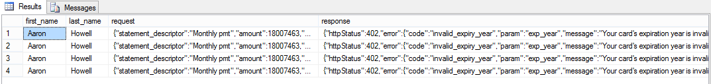
Web Service Logging - Answers
What traffic was originated by this user?
SQL
SELECT acct.first_name, acct.last_name, log.request, log.response
FROM dbo.user_account acct
JOIN dbo.stripe_log log ON acct.username = JSON_VALUE(log.request, '$.username')
WHERE LOWER(acct.first_name) = 'Aaron' AND LOWER(acct.last_name) = 'Howell';
Result
12 |
All information based on typical but simplistic scenarios. Always research before implementing.
Notes:
Aaron Howell tried to pay 4 times but used an expired card
- Joining JSON attributes with a relational table

Slide 13

Request
{ "statement_descriptor":"Monthly pmt", "amount":18007463, "description":"Payment for aaron howell", "currency":"USD", "source":{ "number":"378282246310005", "cvc":"256", "address_line1":"6184 oak ridge ln", "address_country":"USA", "name":"aaron howell", "address_state":"UT", "exp_month":"11", "exp_year":"2005", "address_zip":"36594", "object":"card", "address_city":"surrey" }, "username":"lazymeercat299" }
13 |
All information based on typical but simplistic scenarios. Always research before implementing.
Notes:
Aaron Howell tried to pay 4 times but used an expired card
- Joining JSON attributes with a relational table

Slide 14
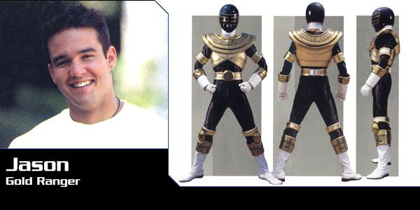
Response
{ "httpStatus":402, "error":{ "code":"invalid_expiry_year", "param":"exp_year", "message":"Your card's expiration year is invalid.", "type":"card_error" }, "username":"lazymeercat299" }
14 |
All information based on typical but simplistic scenarios. Always research before implementing.
Notes:
Aaron Howell tried to pay 4 times but used an expired card
- Joining JSON attributes with a relational table

Slide 15

Web Service Logging - Questions
Answer questions:
What traffic was originated by this user?
What is this user’s CC?
Is the user worth the effort?
See example
See example
See example
15 |
All information based on typical but simplistic scenarios. Always research before implementing.
Notes:
We’ve answered the question of ‘what traffic was originated by this user’

Slide 16
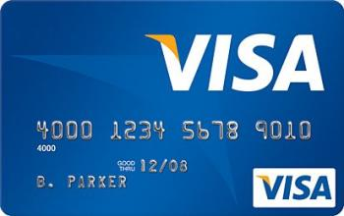
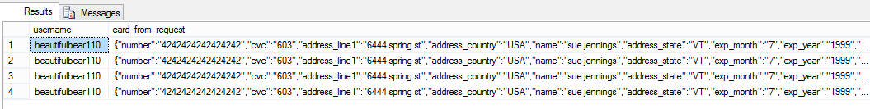
Web Service Logging - Answers
What is this user’s CC?
SQL
SELECT acct.username, JSON_QUERY(log.request, '$.source') AS card_from_request
FROM dbo.user_account acct
JOIN dbo.stripe_log log ON acct.username = JSON_VALUE(log.request, '$.username')
WHERE acct.username='beautifulbear110';
Result
16 |
All information based on typical but simplistic scenarios. Always research before implementing.
Notes:
Aaron Howell tried to pay 4 times but used an expired card
Joining JSON attributes with a relational table
Using JSON_QUERY to get a subset of the request JSON

Slide 17

Web Service Logging - Questions
Answer questions:
What traffic was originated by this user?
What is this user’s CC?
Is the user worth the effort?
See example
See example
See example
17 |
All information based on typical but simplistic scenarios. Always research before implementing.
Notes:
We’ve answered the question of ‘What is this user’s credit card?’

Slide 18
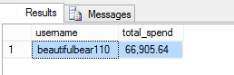
Web Service Logging - Answers
Is the user worth the effort?
SQL
SELECT acct.username, FORMAT(
SUM(
CAST(JSON_VALUE(log.request, '$.amount') AS DECIMAL(10, 2))
)/100.0
, 'N2') AS total_spend
FROM dbo.user_account acct JOIN dbo.stripe_log log ON acct.username = JSON_VALUE(log.request, '$.username') WHERE acct.username='beautifulbear110'
GROUP BY acct.username;
Result
18 |
All information based on typical but simplistic scenarios. Always research before implementing.
Notes:
beautifulbear110 spends a LOT of money at our store
Performing a calculation operation over data in JSON request
- Unindexed field ‘amount’ – no special setup

Slide 19
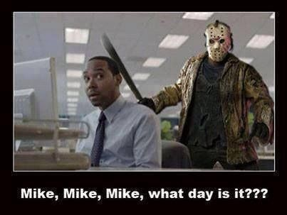
Gotchas
19 |
All information based on typical but simplistic scenarios. Always research before implementing.
Notes:
While building this presentation, we did run into some gotchas

Slide 20
Summary
JSON
SQL Server 2016 native support
randomuser.me
Solution appropriateness
Dynamic data store – not so much
Reporting – okay
Web service logging – good
Answered questions
What traffic was initiated by user?
What is user’s credit card info?
What was user’s total spend?
randomuser.me
20 |
All information based on typical but simplistic scenarios. Always research before implementing.
Notes:
We’ve talked about what JSON is
SQL Server 2016 has native support for working with JSON
We launched a Denial of Service attack against randomuser.me
- That’s not part of the SQL Server 2016 JSON support
We looked at some possible use cases for leveraging JSON in a database
Used SQL Server 2016’s JSON support to answer questions about JSON data

Slide 21

Gotchas
FOR JSON AUTO
Table aliases are required
Escapes forward slashes with backslashes
http://imgur.com/image/edit becomes http:\/\/imgur.com\/image\/edit
Breaks absolute and relative links
Also escapes quotes, tabs, carriage returns, line feeds, and backslash
Couldn’t use with SELECT INTO to generate JSON from an existing schema
21 |
All information based on typical but simplistic scenarios. Always research before implementing.
Notes:
FOR JSON AUTO can’t be used without table aliases
It’s in the MSDN documentation
Tries to be helpful by escaping forward slashes
Breaks URLs
Escapes a bunch of other things
Be aware if you expect the data you put in to be the same as what you get out
Can’t use SELECT INTO with FOR JSON AUTO to generate JSON from existing tables

Slide 22
Gotchas
Indexing
Requires extra legwork
Computed columns
Turns JSON text into tabular storage
22 |
All information based on typical but simplistic scenarios. Always research before implementing.
Notes:
Can’t use JSON_VALUE with ntext column
- It’s OK because nvarchar can store a LOT of JSON
Indexing requires computed columns
- If you want to index more than a few fields, ask whether storing the data as JSON really makes sense

Slide 23



https://github.com/tsaiclone/json-demo

